Slide 1
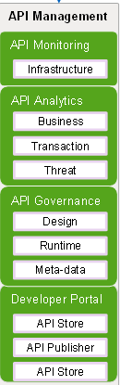
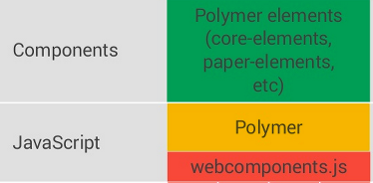
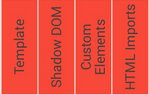

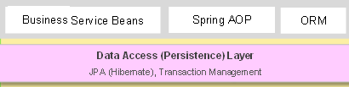
SCF Portal – Logical Architecture
Designed Framework Supports
Integration using REST API for SCF Portal(Polymer)
Separation of UI logic and business / data logic
Event aggregation, custom events and delegation of DOM Events
Declarative UI binding
Data Validation & Logging using SL4J
Data Caching & Business Data Persistence using JPA
Authentication & Authorization using TPA
URL mapping or rewriting or URL routing system
Integration with PEGA CRM with (SOAP) / REST Services.
API Gateway and Management using Acess Token
Firewall
API Gate
Firewall
Shared Services
ING Private Cloud
Infrastructure
Data Management
DevOps tooling/CDaaS
Tomcat Server
Service Discovery
^{Frontend Web App}
TPA
Polymer
Polymer SDK
Spring Boot Framework
Rest Services
Pega CRM
Firewall

Slide 2
Mortgage Portal – Logical Architecture
Designed Framework Supports
Integration using SOAP & REST API for Channels
Separation of UI logic and business / data logic
Event aggregation, custom events and delegation of DOM Events
Declarative UI binding
Data Validation & Logging using SL4J
Data Caching & Business Data Persistence using JPA
Authentication & Authorization
URL mapping or rewriting or URL routing system
Abstraction for offline (local) storage
Integration with Stater Web Service (SOAP) / REST Services using WSO2
API Gateway and Management using WSO2
Insight using Cognos
Easy Integration with CMS Product like Liferay

Slide 3
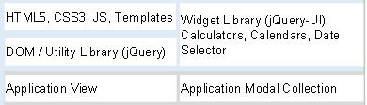

SCF Portal – Logical Architecture
Designed Framework Supports
Integration using REST API for SCF Portal
Polymer UI components in build with Polymer SDK.
Separation of UI logic and business , data logic.
Event aggregation, custom events and delegation of DOM Events
Declarative UI binding
Data Validation & Logging using Log back
Authentication & Authorization using TPA
URL mapping with Service discovery
Integration with PEGA CRM with (SOAP) / REST Services.
API Gateway and Management using Acess Token
Tracing and Monitoring supported by GMTT.
Domain Firewall
API Gate
Corporate Firewall
Shared Services
ING Private Cloud
Infrastructure
Data Management
DevOps tooling/CDaaS
Tomcat Server
Service Discovery
^{Frontend Web App}
TPA
Polymer & Polymer SDK
Polymer
Polymer SDK
Spring Boot Framework
Rest Services
Pega CRM
Firewall

